Slide 1
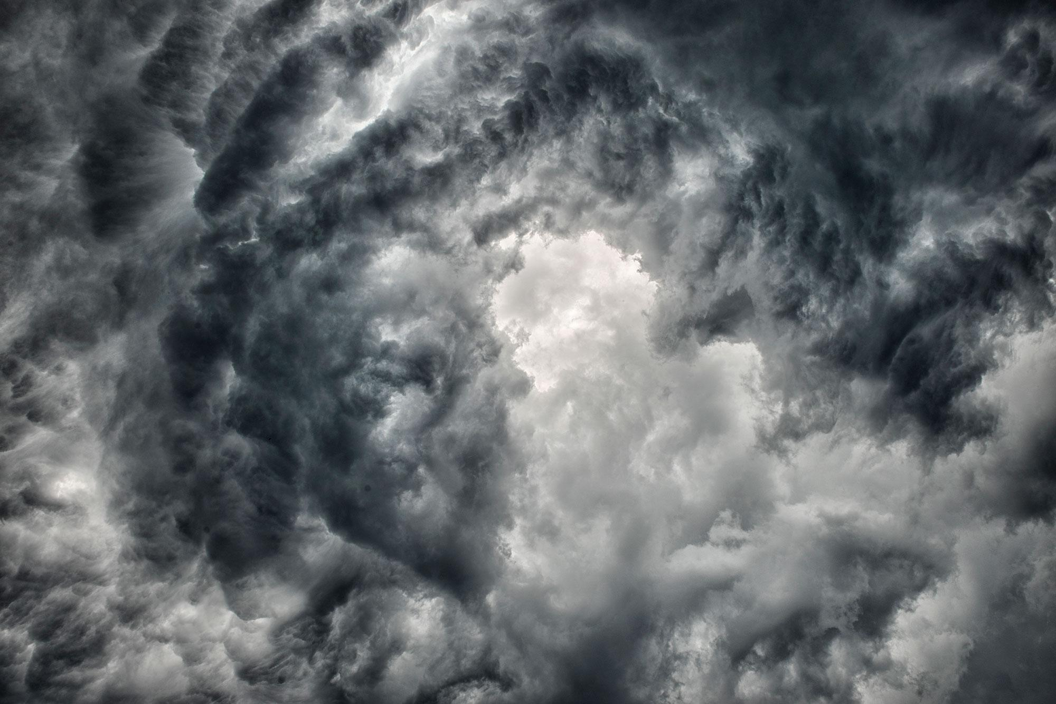
Twitter Dashboard for Disaster Events

Slide 2
Original Task
2
Create a project that will leverage news feeds relevant to specific disasters, gathered from multiple sources, to create a webpage that presents these live feeds under one umbrella. This is similar to the Google News feature.

Slide 3
Problem Statement
?
Twitter lends itself for live information sharing. However, informative signals are often clouded with irrelevant noise.

Slide 4
SITUATIONAL AWARENESS
Our goal is to help filter and triage where actionable help is needed.

Slide 5
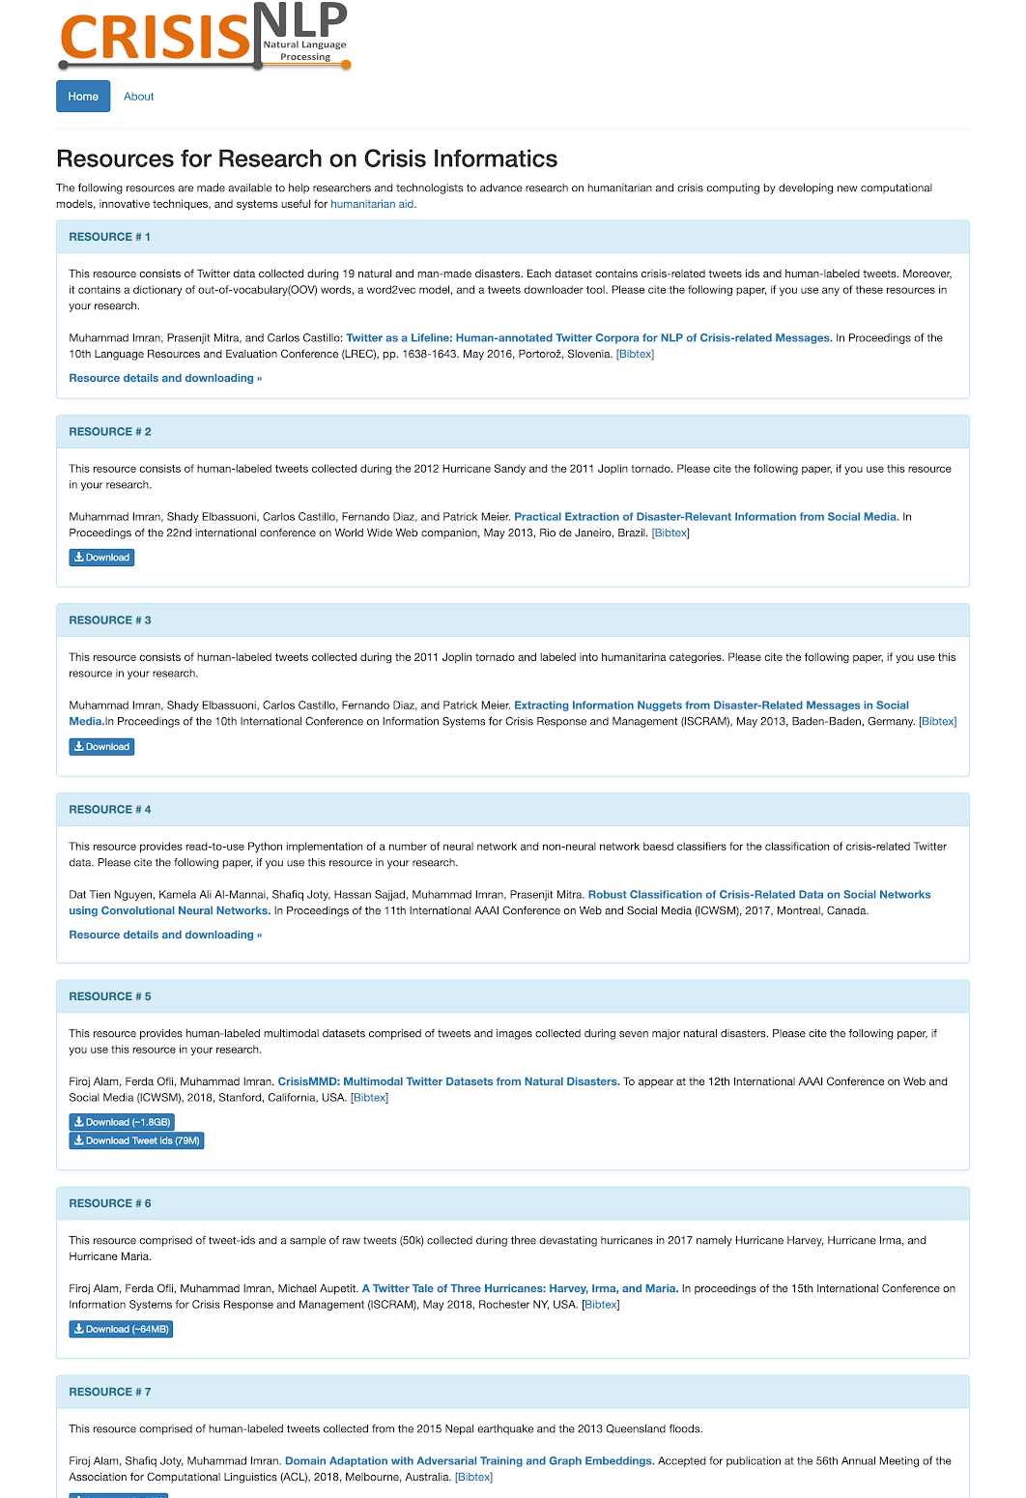
Training Data
Human-Labeled
~4,000 tweets from Hurricanes Maria, Harvey, and Irma
~3,000 tweets from Hurricanes Sandy and Tornado Joplin

Slide 6
Training Set Labels
Category | Share
Not informative | 33.7%
Casualties and damage | 20.8%
Caution and advice | 17.6%
Informative, other | 15.3%
Information Source | 8.8%
Donations of money, goods or services | 3.9%
TOTAL | 100.0%

Slide 7
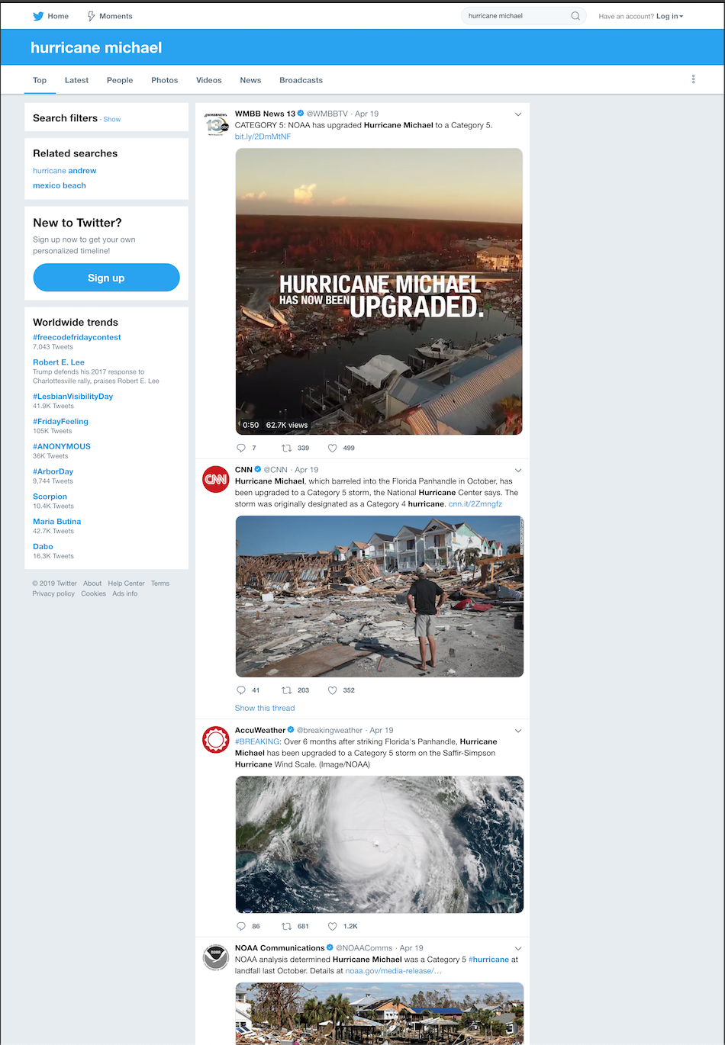
Testing Data
Hurricane Michael: Most Recently FEMA-Declared Disaster (Hurricane)
via GetOldTweets Python Library
October 9 - 16, 2018
Unlabeled tweets
Search term: “hurricane michael”
~300,000 tweets

Slide 8
Cleaning and Preprocessing
Lowercase
String removal (e.g. “RT”)
Duplicate removal
TweetTokenizer
Truncates elongations
Removes Twitter handles

Slide 9
Cleaning and Preprocessing: Tweet Tokenizer
“@remy: This is a cooooooool #dummysmiley: :-) :-P <3”
['This', 'is', 'a', 'coool', '#dummysmiley', ':', ':-)', ':-P', '<3' ]

Slide 10
MODEL WORKFLOW
TOKENIZE
VECTORIZE
MODEL

Slide 11
Models
Model | Train | Test
Logistic Regression | 0.987 | 0.871
SVM | 0.969 | 0.817
Naive Bayes w/TF-IDF | 0.822 | 0.624
Naive Bayes w/CVEC | 0.924 | 0.702
Random Forest | 0.502* | 0.427*
* R Squared

Slide 12
Models
Logistic model had highest accuracy (.87 on test)
Also modeled tweets from Hurricanes Harvey, Irma, Maria
Logistic model accuracy: .71 on test
Incompatible, less informative labels
Used Sandy-Joplin LR model to predict tweet categories for Hurricane Michael tweets

Slide 13
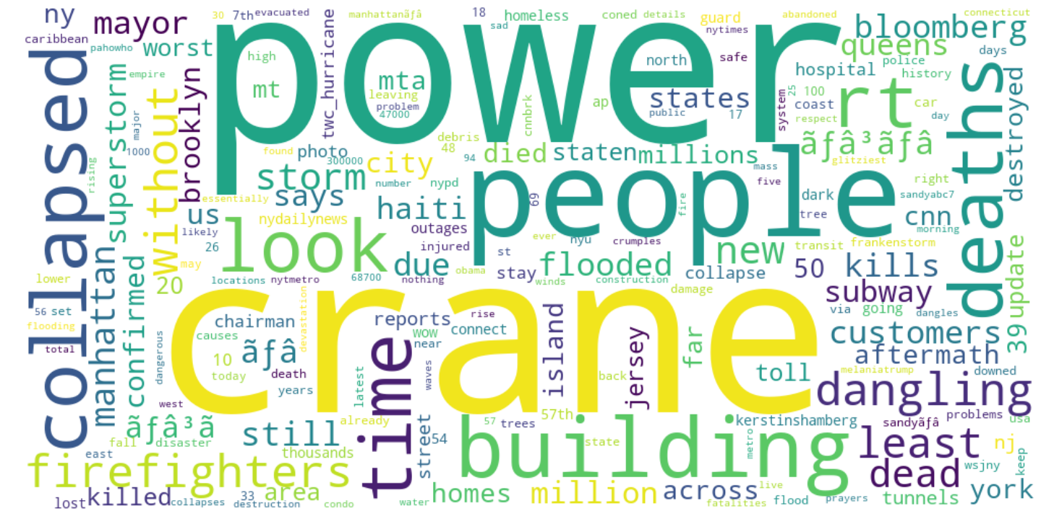
Sandy-Joplin - Casualties and Damage

Slide 14
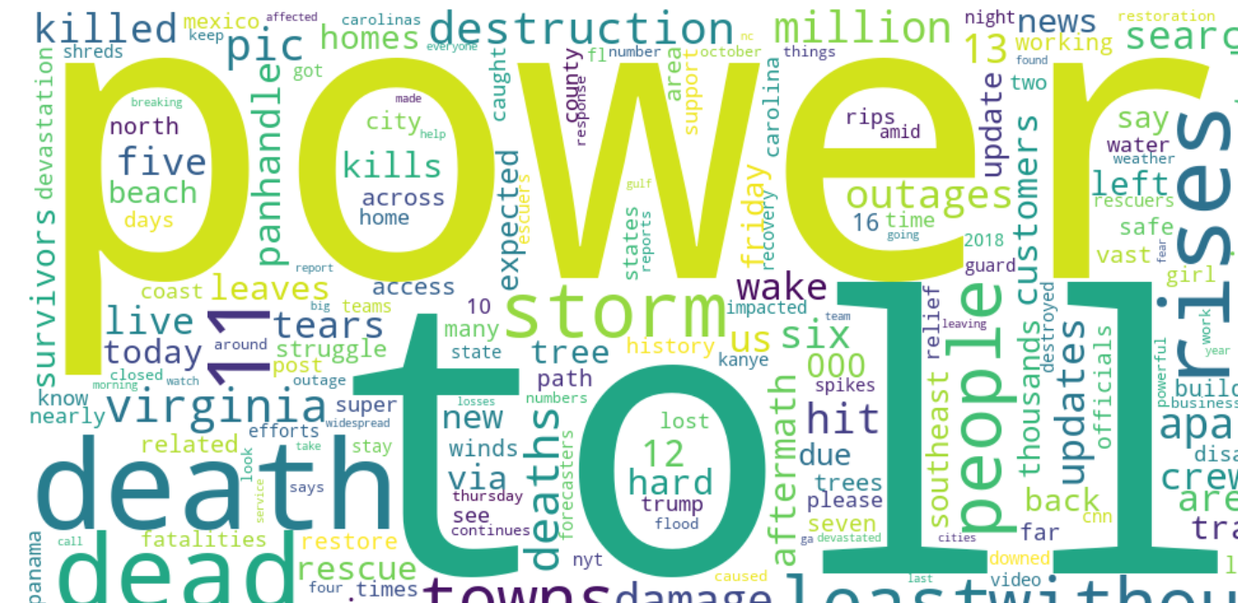
Michael - Casualties and Damage

Slide 15
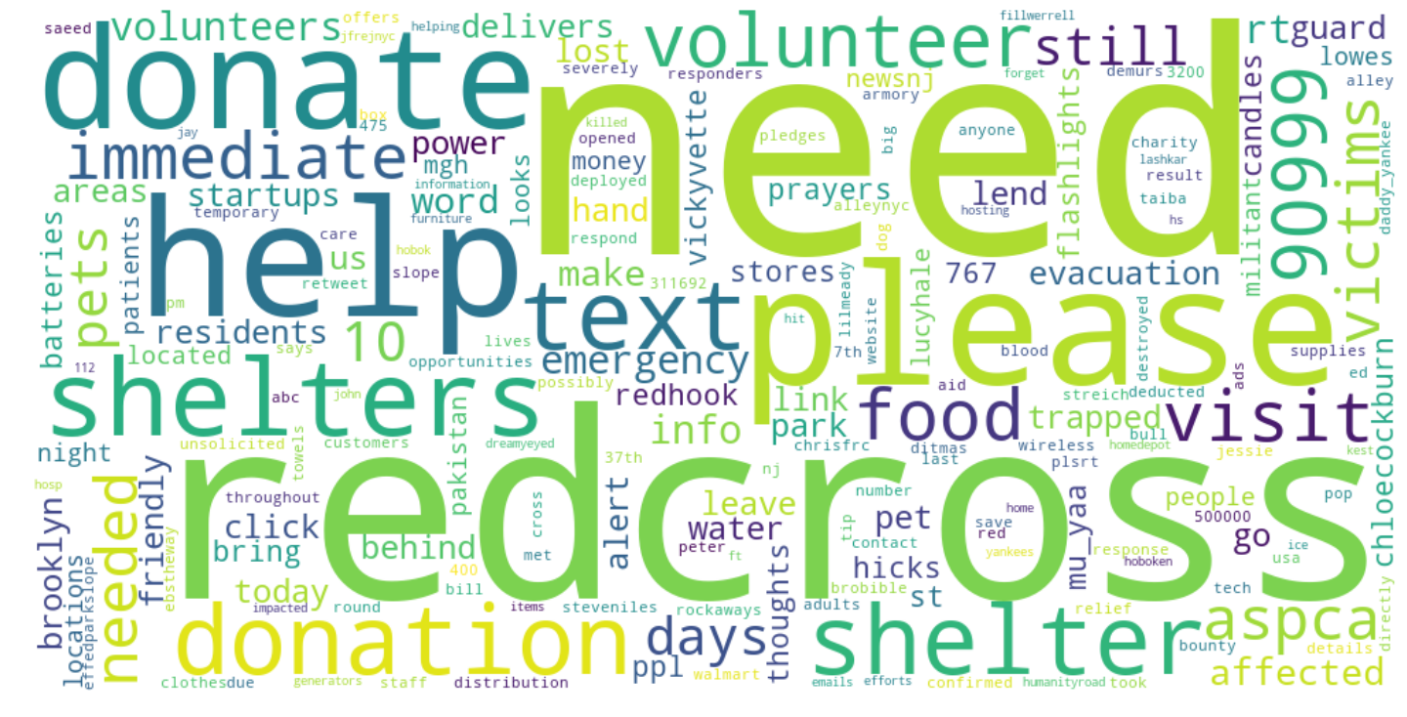
Sandy-Joplin - Donations

Slide 16
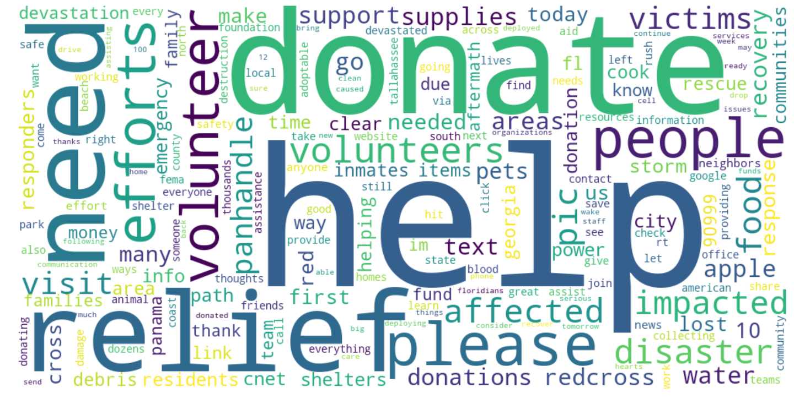
Michael - Donations

Slide 17
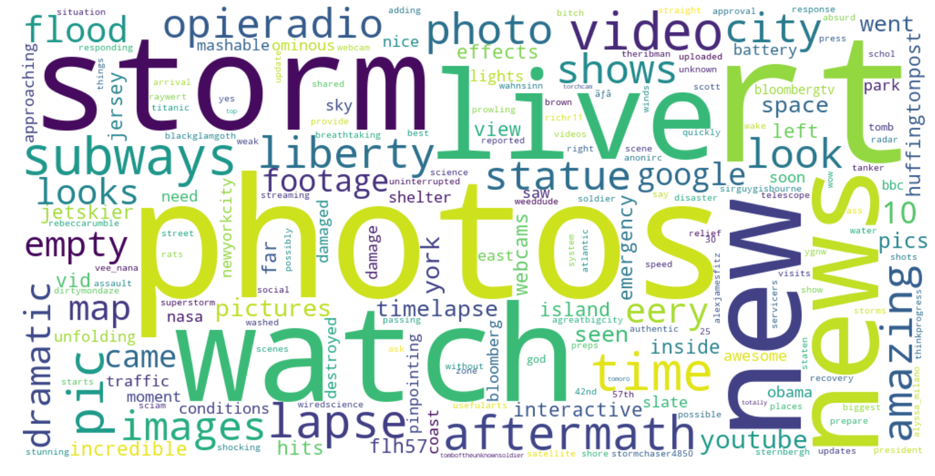
Sandy-Joplin - Information Sources

Slide 18
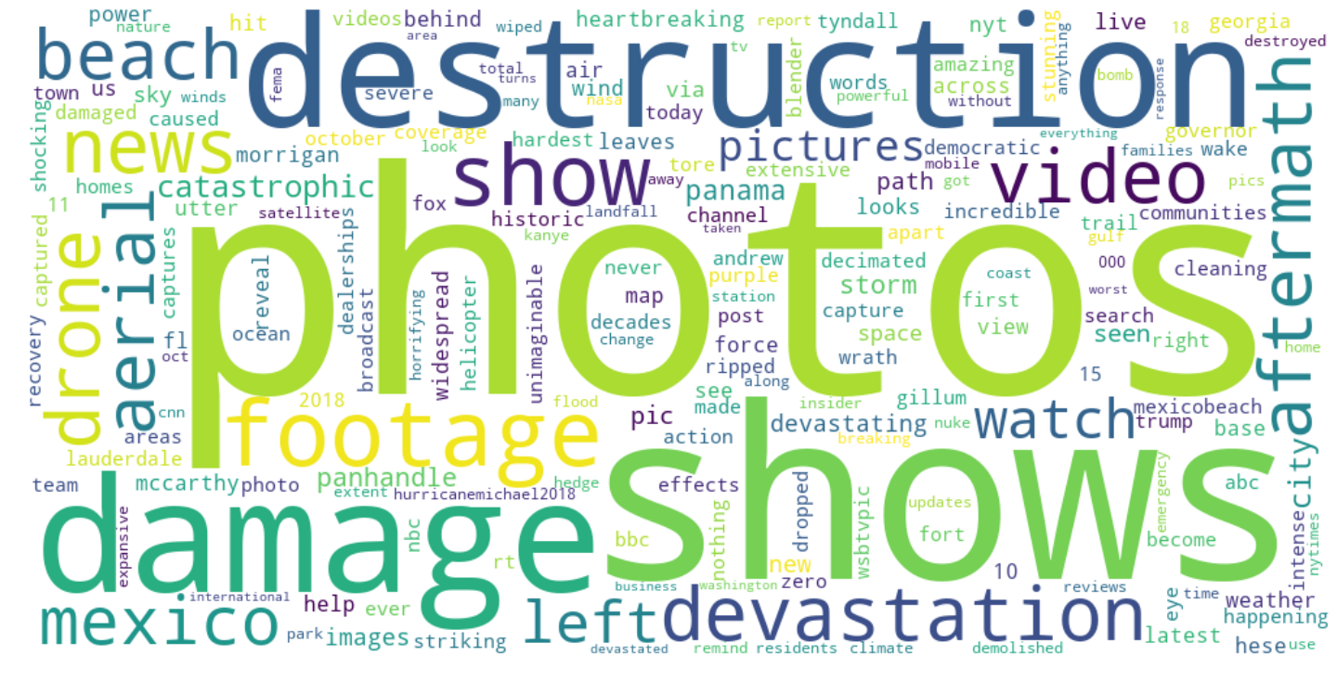
Michael - Information Sources

Slide 19
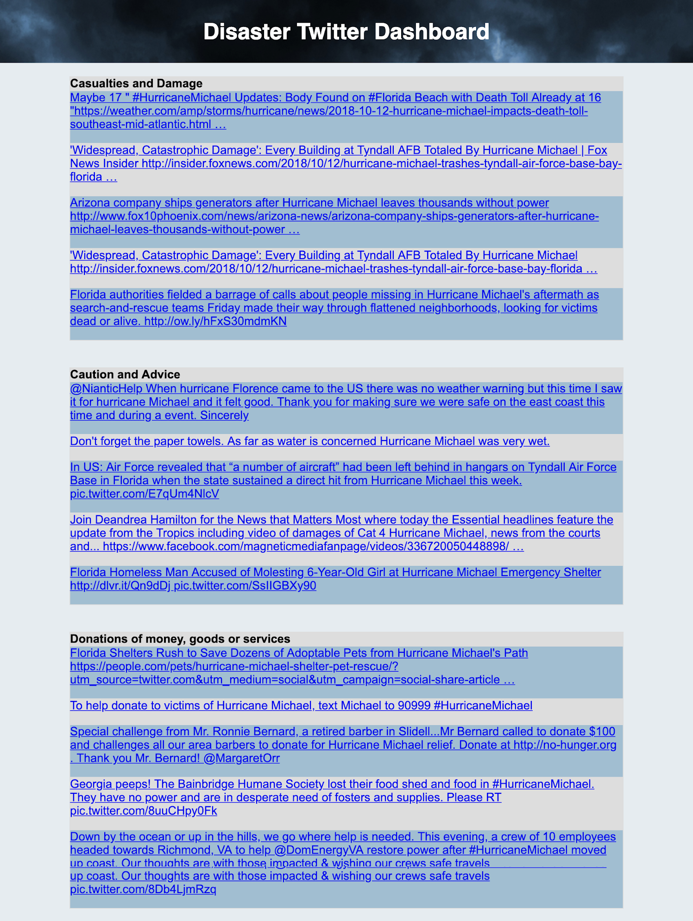
TWITTER
DASHBOARD
Current prototype of the dashboard

Slide 20
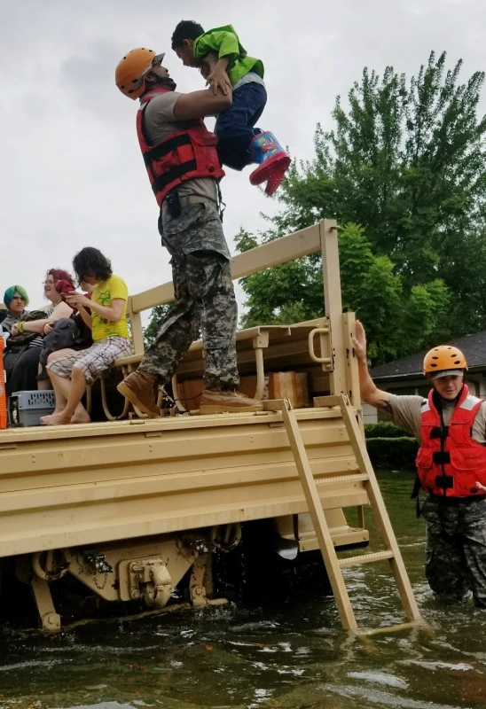
Takeaways
Room for improvement
More labeled data/tweets
Try other natural disaster types (aside from hurricanes)
Further dashboard web development
Implications of the work

Slide 21
THANKS
ANY QUESTIONS?
Code: https://git.generalassemb.ly/PaulSchimek/disaster

